Slide 1
The Cross and the Lynching Tree
By James Cone

Slide 2
Roman Imperialism
Crucifixions

Slide 3
The World of Jesus

Slide 4
Galilee
Scattered Villages Dominated by Sepphoris and Tiberias
Gentrification
Migration
Agricultural Towns and Villages
Dominated by Sepphoris and Tiberias
Plagues and Malaria
Shortages of Males
Overall Wealth Not Per Capita

Slide 5
Disease
Life Expectancy
70% die in first five years.
Average Life Span is 24 years.
Malaria
Anemia
Gastrointestinal Diseases
Tuberculosis
Typhoid Fever

Slide 6
Life in the Villages and Towns
Sudden Deaths;
Breakdown of Extended Families as Resources;
Young Men Commute and Relocate for Work;
Men die early;
Children rarely meet their grandfathers;
20-40 million people relocate constantly.

Slide 7
Women
married shortly after puberty;
bore children until menopause;
often died in childbirth;
had little chance of marriage past 30;
were commonly “middle-aged” widows;
were expected to bear five to nine children;
lived in the context of near universal marriage.

Slide 8
Daily Surroundings of the Peasantry
Rule and Power
Rome
Jerusalem
Sepphoris
Tiberias

Slide 9
Everyday Life
Malnutrition and Sickness
Oppression of Farmers
Mental Illness
Lame Children
Blind Parents
Slavery and Bondage

Slide 10
The Aristocracy
The Constitution gave governmental power to aristocrats.
Aristocrats partnered with the Empire to Keep Order
They thereby gained benefits, wealth and power
Ultimate power rested with four elite families;
They collected governmental taxes.
They applied Roman law.
They were to prevent revolts

Slide 11
Jerusalem
City of God - Faithless City
City of Hope - City of Oppression
City of Joy – City of Pain
Ancient History – Since David and Solomon
Sacred Center of Jewish World
Words of the Prophets
Jesus’ Sadness for Jerusalem

Slide 12
The High Priest
had same priveleges as aristocrats;
were appointed by Roman Empire;
were responsible for protection of Jewish society as a whole;
were to control Jewish society in interest of Empire;
depended on Roman power for the maintenance of their positions of power.
were conflicted – maintain interests of Empire vs. maintain well-being of Jewish community, mostly peasants.
resolved the conflict by avoiding conflict with Empire.

Slide 13
Resistance
Banditry
Pre-political Rebellions
Messianic Movements
Slave Resistance
Larger Revolts

Slide 14
Crucifixion
Assyria – A general term for the display criminals after physical torture.
Persia – Darius 3,000 – Outside the City
Greece – Alexander 10,000
Rome – As many as 5,000 along the Roadside

Slide 15
James Cone – the Connection
Video

Slide 16
The Jim Crow Era
lynching

Slide 17
Historical Context
End of Slavery
Reconstruction
Demise of Reconstruction
Social Darwinism
Pseudo – Science
Lynching

Slide 18
Historical Context
It arose after Federal Troops were removed from South, 1877.
The South Immediately Instituted Black Codes.
National government passed 13th, 14th and 15th Amendments.
Reconstruction only lasted until 1877.
Federal Troops are Withdrawn.
Jim Crow lasted legally until 1954 – Brown vs. Topeka Bd. Of Education Decision.
Civil Rights Movement had to be fought to enforce the law.

Slide 19
Racist Interpretations of Scripture
Curse of Ham
Mark of Cain

Slide 20
The Cross: Atonement Theology
Atonement Theology
Anselm, Satisfaction Theory, 11th Century
Christus Victor, Church Fathers, 100-700 CE
Abelard, Moral Influence, 1079-1142
Irenaeus, Ransom, 100-200 CE
Penal Substitution, Middle Ages

Slide 21
Ku Klux Klan: History
Founded, 1866, Pulasky, Tennessee
Linked Itself to Crusades – Effort to Free Holy Lands from Infidel Turks
Linked its History to Anglo Saxon History

Slide 22
Ku Klux Klan: Membership and Symbolish
Membership
Caucasian
Protestant
Native-Born Americans
Symbolism
Cross Insignia
Circle Filled with Blood of Christ
Red Teardrop = Blood of Jesus Shed for Humanity
White Robes

Slide 23
The Cross: Ku Klux Klan
Symbol of White Supremacy and Nationalism
Whiteness = Purity
United Klan Community under God’s Control
Christ = Light of the World
God would triumph over evil.
Light Vanquishes Darkness.
Present at Lynchings
Video - Brief History

Slide 24
The Cross: Ku Klux Klan
Purges out Evil
Immigrants
Alcohol
Threats to Public Schools
Attacks on Protestants
Purifies Klansmen
Burns off Vices
Gives Entitlement to Conquer Lands
Purges Lands of Anti-Christ
Terrifies

Slide 25
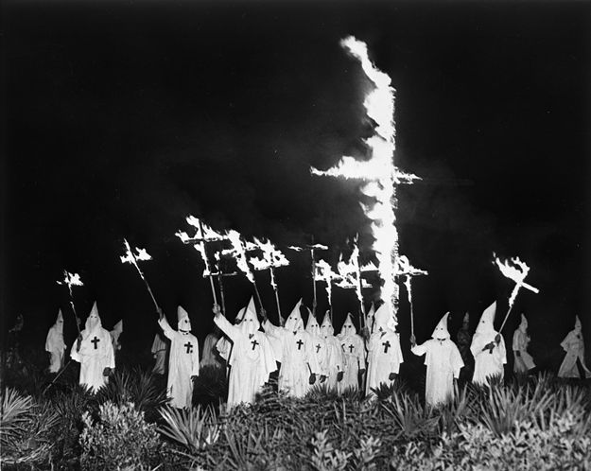
The Cross: Ku Klux Klan

Slide 26
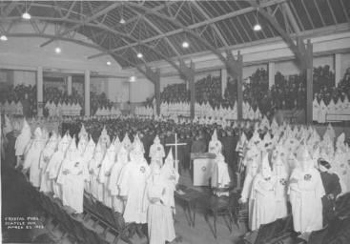
The Cross: Ku Klux Klan

Slide 27
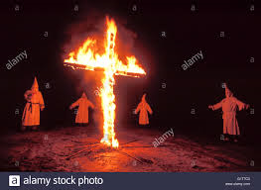
The Cross: Ku Klux Klan

Slide 28
Lynching Rituals: The KKK
1877-1950, 4,800
Restore the Social Order/White Supremacy
Purity/Virtue of White Woman
Freedom from Moral Contamination
Aimed at Black Men
Based on Biblical Literalism
Enforcing White Supremacy

Slide 29
KKK Premises
“How does the cross, which stands for the ultimate symbol of God’s victory over power of sin and death, become the accepted symbol of “night riders” and lynching? “ Stephen Ray, “Contending for the Cross”.
PREMISES
Christianity = Western
Racialization of Faith
Modernity – Military Combat with “Others” is justified because they are infidels.
It is Consistent with Manifest Destiny and Colonialism.
Western Christianity is considered the religion of settlers.
Christianity = Cult of White Supremacy.

Slide 30
KKK Theology
Basic Premises
Strident Nationalism
White Supremacy
Homogeneity of White Protestant Nation
Conflated Nationalism and Protestantism

Slide 31
The Church: Complicity and Silence
The KU Klux Klan
White Evangelicalism – Sin and Salvation
Leading Theologians
Deidrich Bonhoeffer
Reinhold Niebuhr

Slide 32
African American Response
Reframing
Recontextualizing
Black people are martyrs
Jesus has bonded with Black victims of lynching in their suffering.
Black people are the true recipients of salvation and redemption.
Suffering is a passage to resurrection, healing and ultimate victory.
Black people are the real bearers of the robes described in Revelation.

Slide 33
The Cross: African American Sacred Music
Oh, Happy Day!
How I Got Over
Sister Rosetta Tharpe, "Up above my head, there is music in the air!"
Katie Sankey, "I Don't Know Why"
Suffering as Passageway to Healing and/or Victory
Womanist Theologians – Delores Williams and JoAnne Terrell

Slide 34
James Cone: On The Beloved Community
Cone on Forgiveness

Slide 35
THE ERAS OF OBAMA AND TRUMP
KILLINGS OF INNOCENT BLACK MEN

Slide 36
Historical Context
Obama Election – 2008
Obama Re-Election – 2012
Trump Election - 2016

Slide 37
Historical Context
The War on Drugs
The New Jim Crow
The War on Terror
Mass Deportation and Detention

Slide 38
The New Crucifixion
The Browder Story

Slide 39
Theology and the Black Struggle
Reinhold Niebuhr
Social Gospel
Dietrich Bonhoeffer
Martin Luther King
James Cone

Slide 40
Theology and the Black Struggle
The African American Church
Black Nationalism and the Black Christ
Hope – Suffering as a Passage
Music
The Resurrection – He Got Up!!
Glory!!

